Slide 1
Salmon vs STAR
04/25/2023
ANGSD Project Presentation
Mohith Arikatla
MS Computational Biology 24’

Slide 2
Project learning objectives
End-to-end NGS Data Analysis
Formulating and testing a strategy
Learn to manage and process sequencing data
Evaluate the quality of the data at all stages
Interpret results
Document the process (with an emphasis on reproducibility)

Slide 3
The Question
Hypothesis: There will be a significant difference in the enriched pathways when different quantification algorithms are used. (Classical alignment vs Pseudo-mapping Algorithm)
Method: Obtain feature count data using an alignment algorithm and a pseudo-mapping algorithm and process them in the same way to perform pathway analysis and then compare the enriched pathways

Slide 4
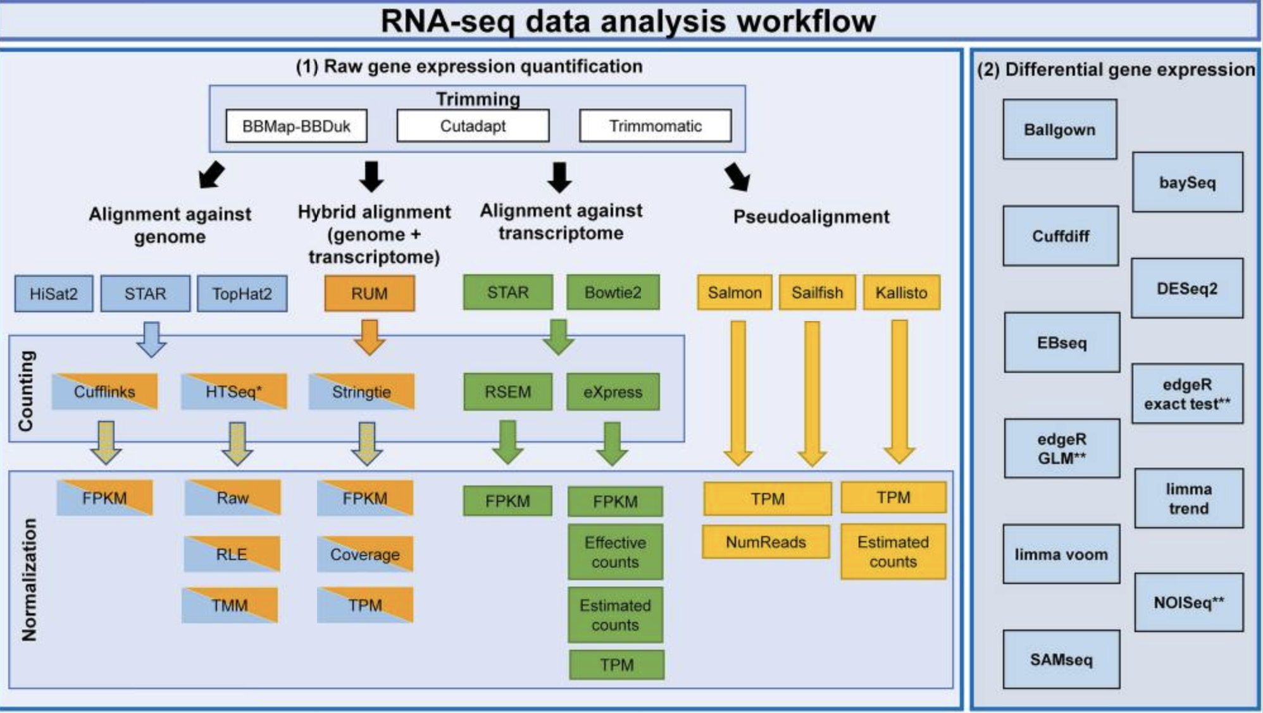
Decisions Decisions
Which pipeline do I use?
How long do you have?
What is your end goal?
Corchete et al., 2020
Notes:
Corchete LA, Rojas EA, Alonso-López D, De Las Rivas J, Gutiérrez NC, Burguillo FJ. Systematic comparison and assessment of RNA-seq procedures for gene expression quantitative analysis. Sci Rep. 2020;10(1):19737. Published 2020 Nov 12. doi:10.1038/s41598-020-76881-x

Slide 5
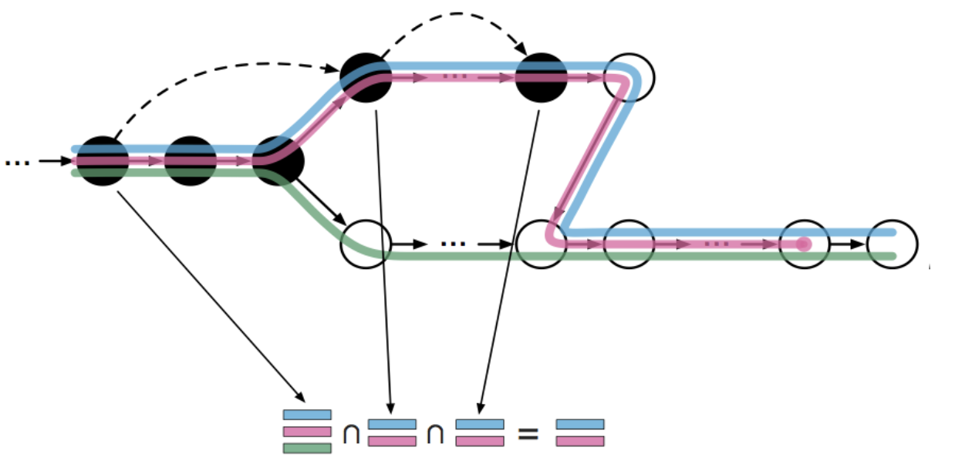
What is pseudo-alignment?
It’s NOT necessary to do a full alignment of the reads to the genome which is often the slowest step in sequencing analysis
Instead, the raw sequence reads are directly compared to transcript sequences and then used to quantify transcript abundance
Pseudo-aligners have an advantage in terms of the time of computation through skipping redundant hash-mappings
https://tinyheero.github.io/2015/09/02/pseudoalignments-kallisto.html

Slide 6
Comparison
Feature | Salmon | STAR
Genome Reference |  | x
Transcriptome Reference | x | x
Needs annotation | x
Alignment |  | x
Pseudo-alignment (Only quantification) | x | x
Expression Values | x | x
Splice aware |  | x

Slide 7
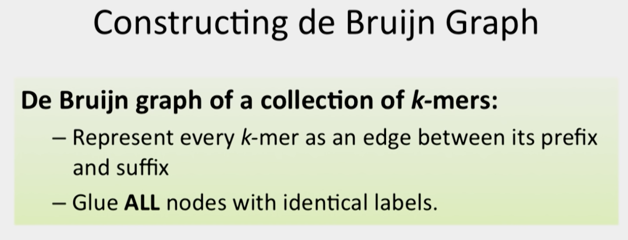
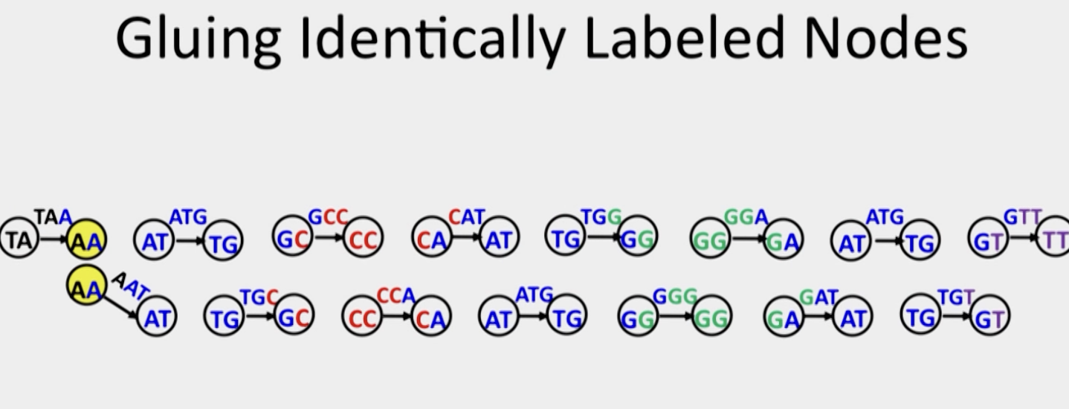
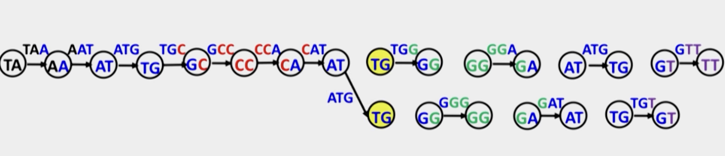
Why does Salmon need a transcriptome?

Slide 8
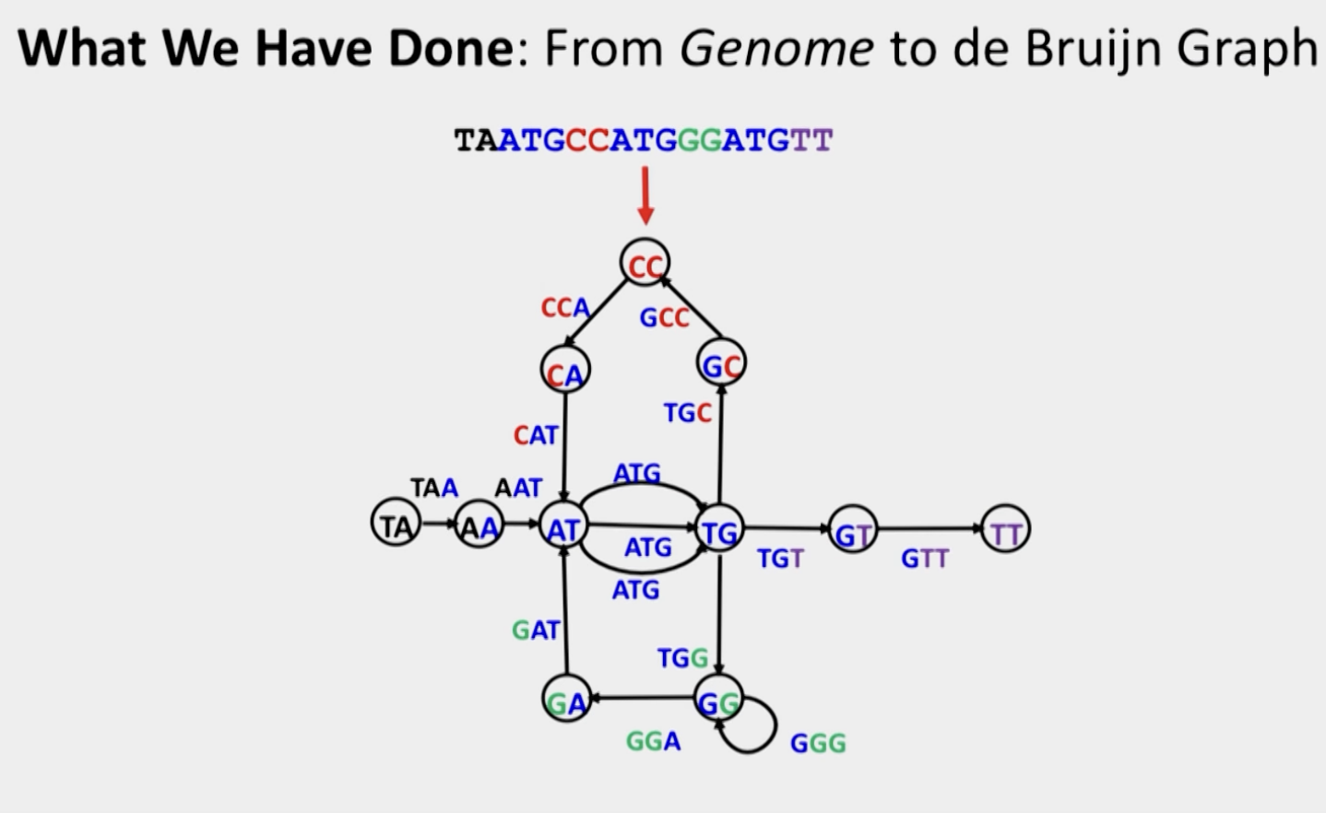
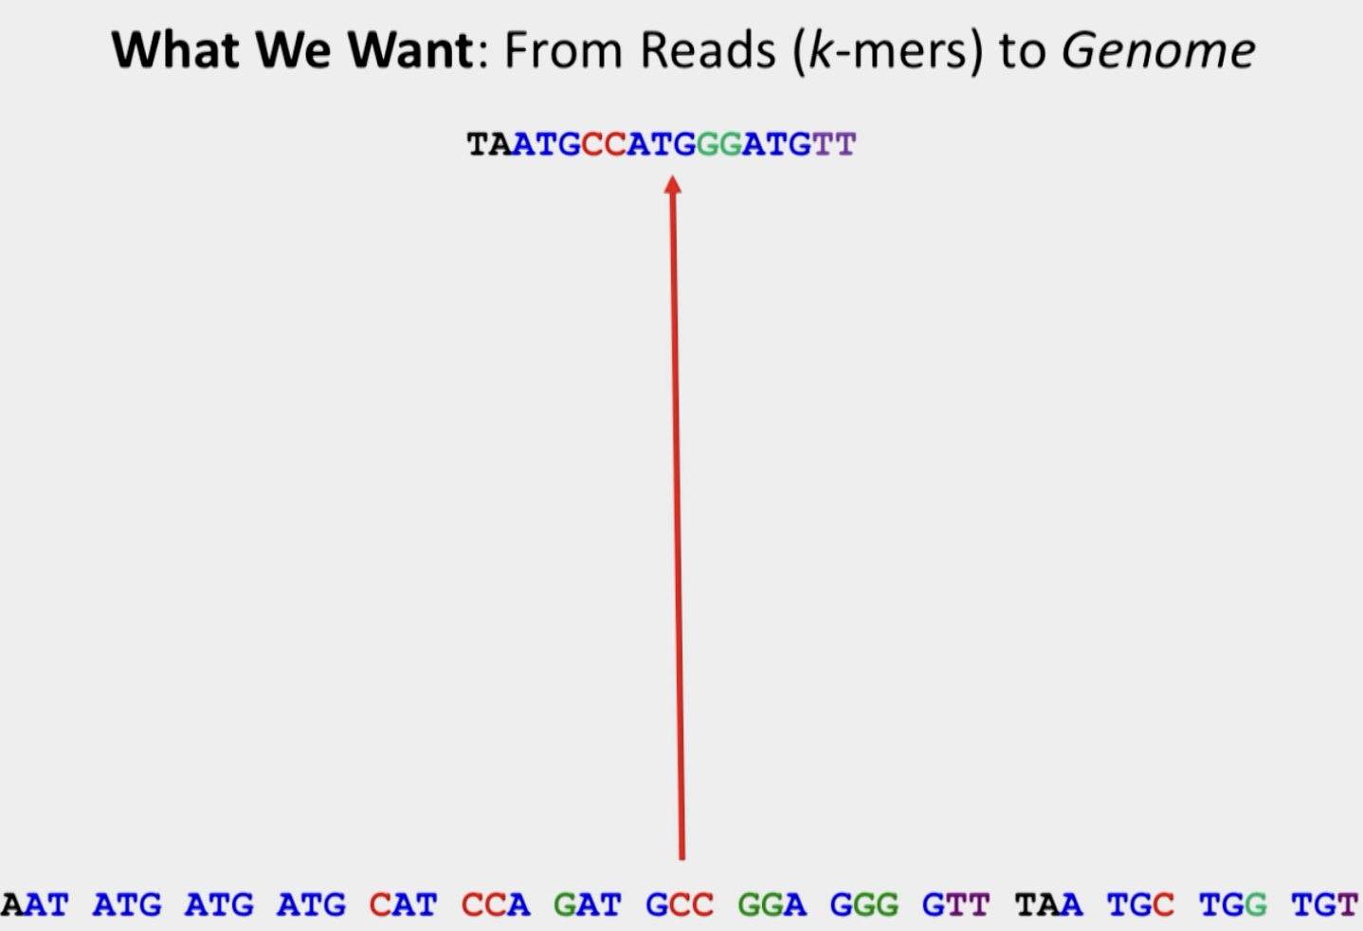
Why does Salmon need a transcriptome?

Slide 9
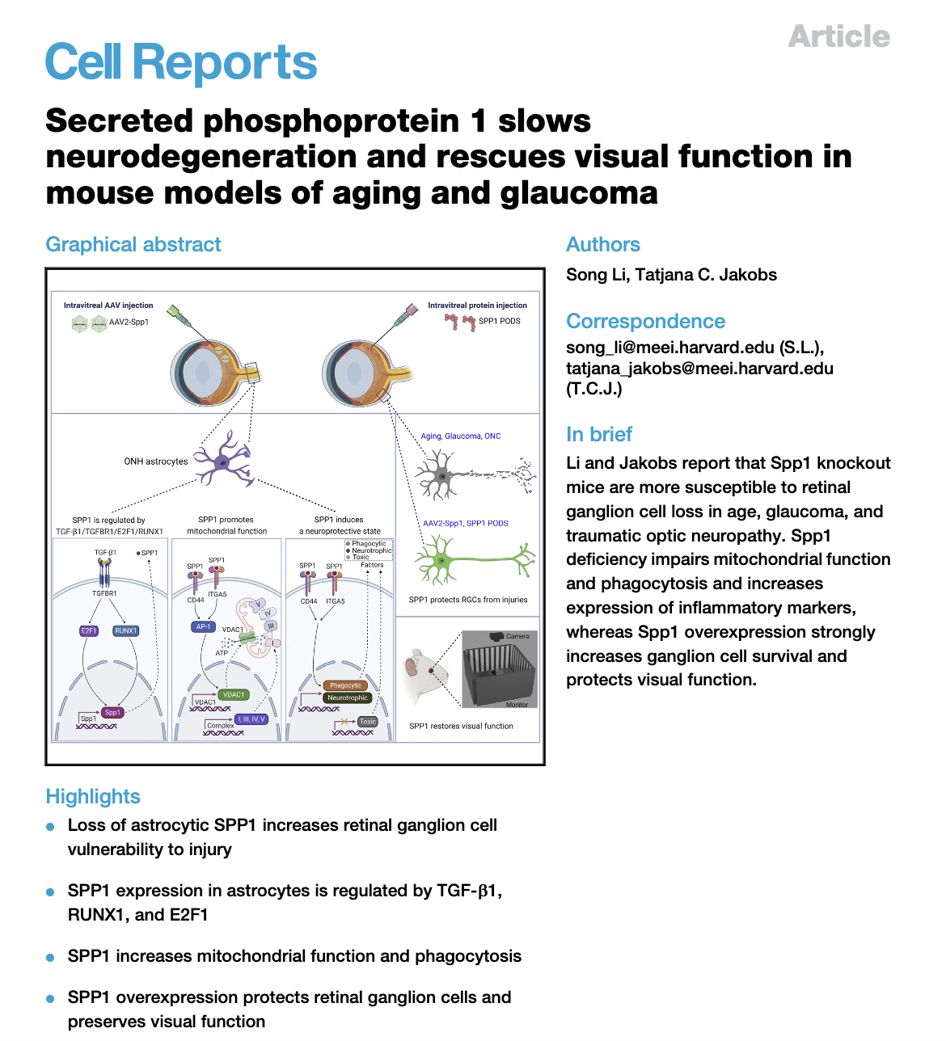
Dataset
Experimental design: Astrocytes mRNA profiles of wild type and Spp1 KO neonatal mice
Sequencing - Illumina NovaSeq 6000
Alignment (GRCm38) - STAR software package
Differential expression analysis - DESeq2
Results:
Reads obtained - 40 million raw reads per sample
DEGs - 3624 (fold change ≥1.5 and p value <0.05)
1991 were upregulated and 1633 were downregulated in the Spp1−/− astrocytes

Slide 10
Secreted phosphoprotein 1 slows neurodegeneration and rescues visual function in mouse models of aging and glaucoma
Results:
Reads obtained - 40 million raw reads per sample
DEGs - 3624 (fold change ≥1.5 and p value <0.05)
1991 were upregulated and 1633 were downregulated in the Spp1−/− astrocytes

Slide 11
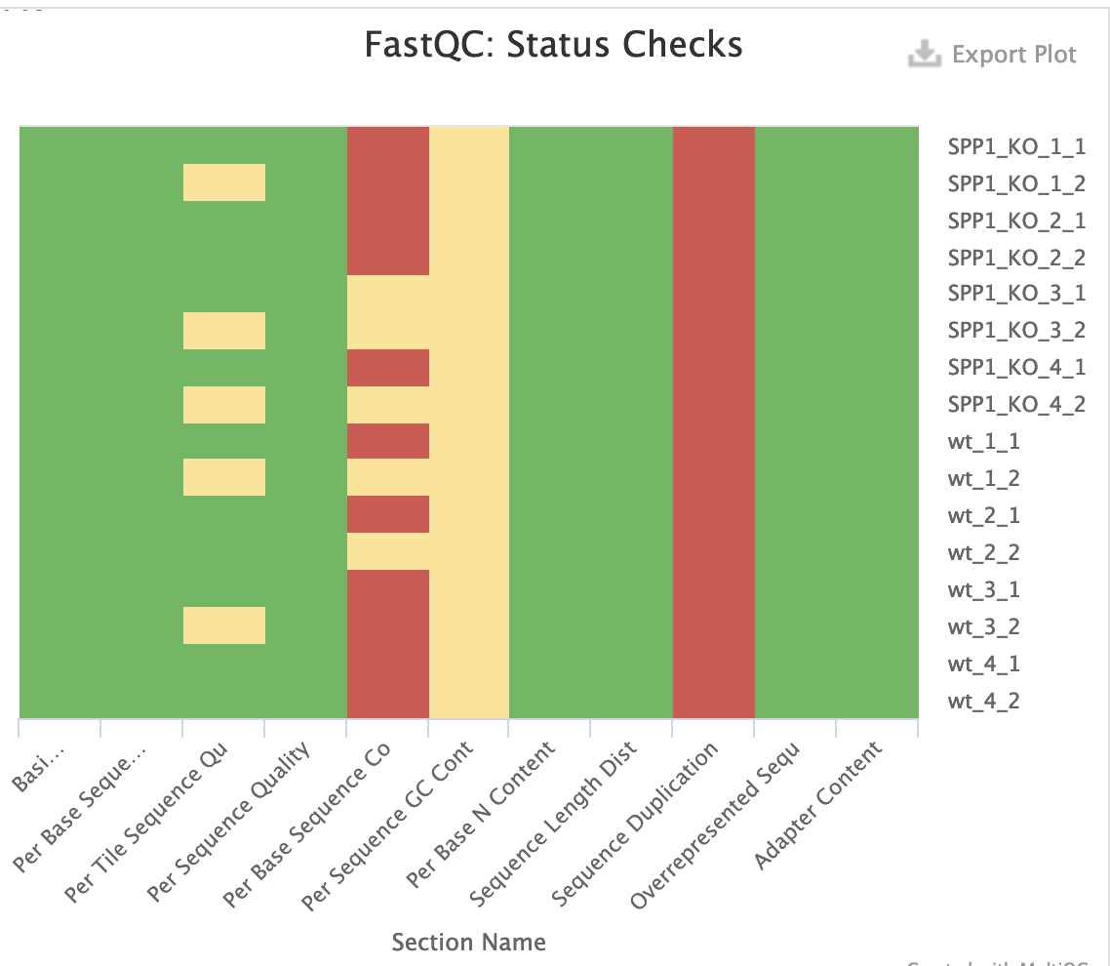
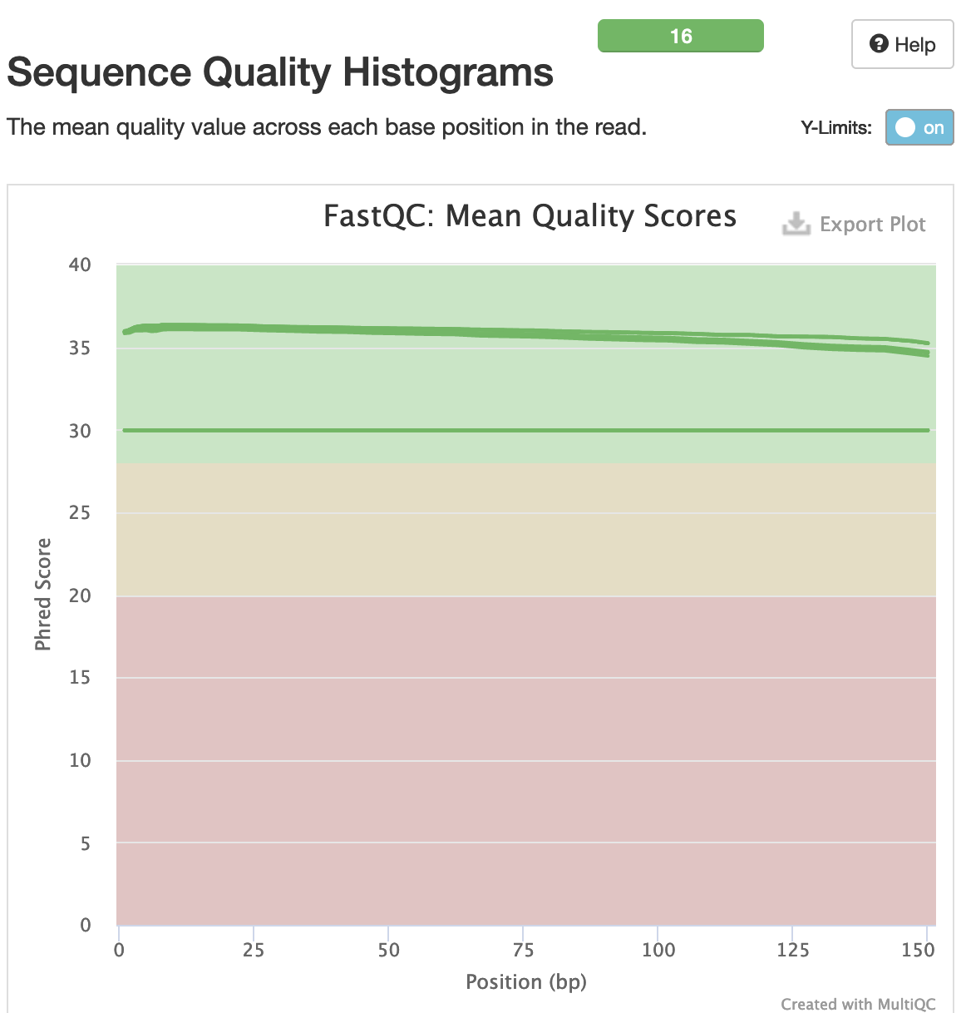
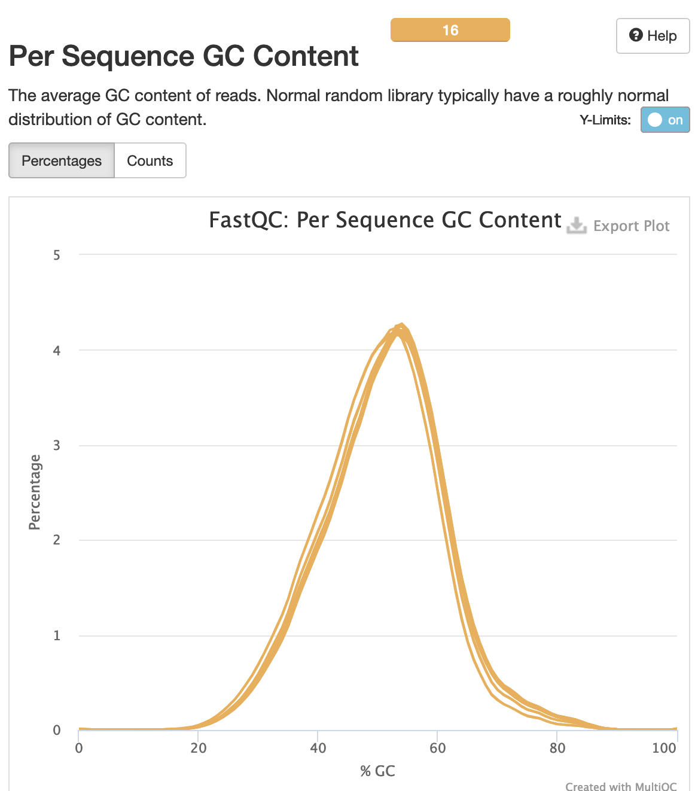
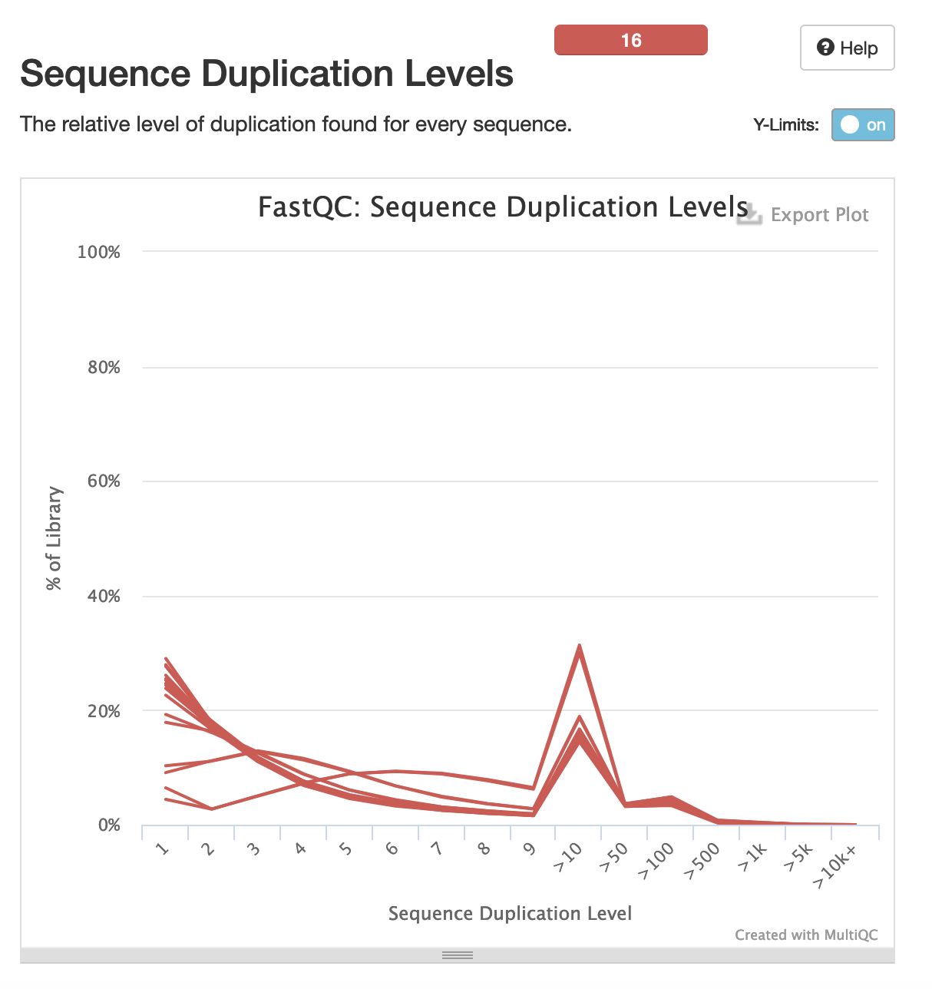
FASTQC

Slide 12
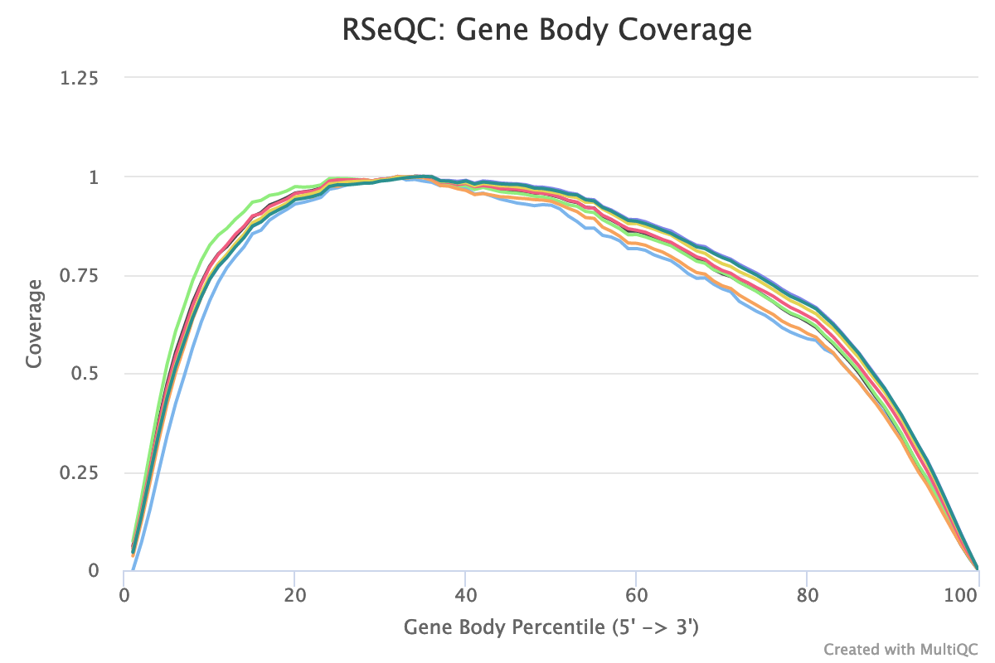
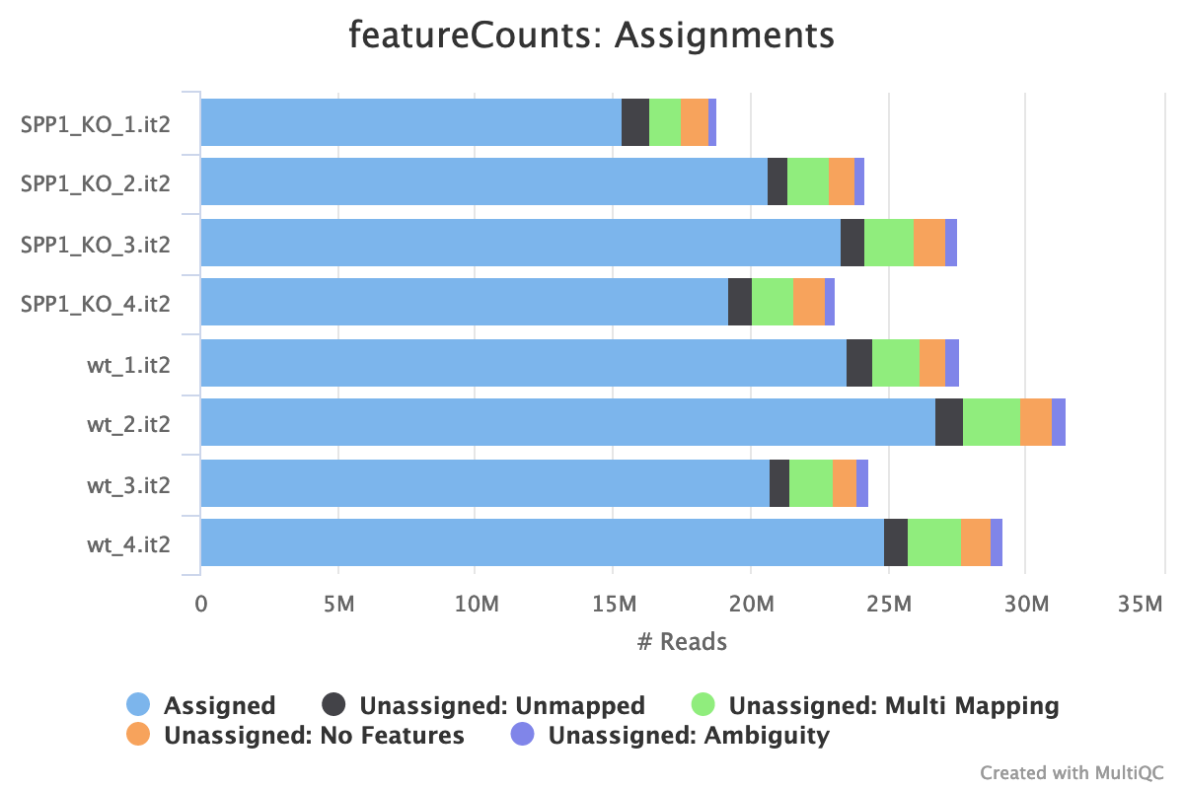
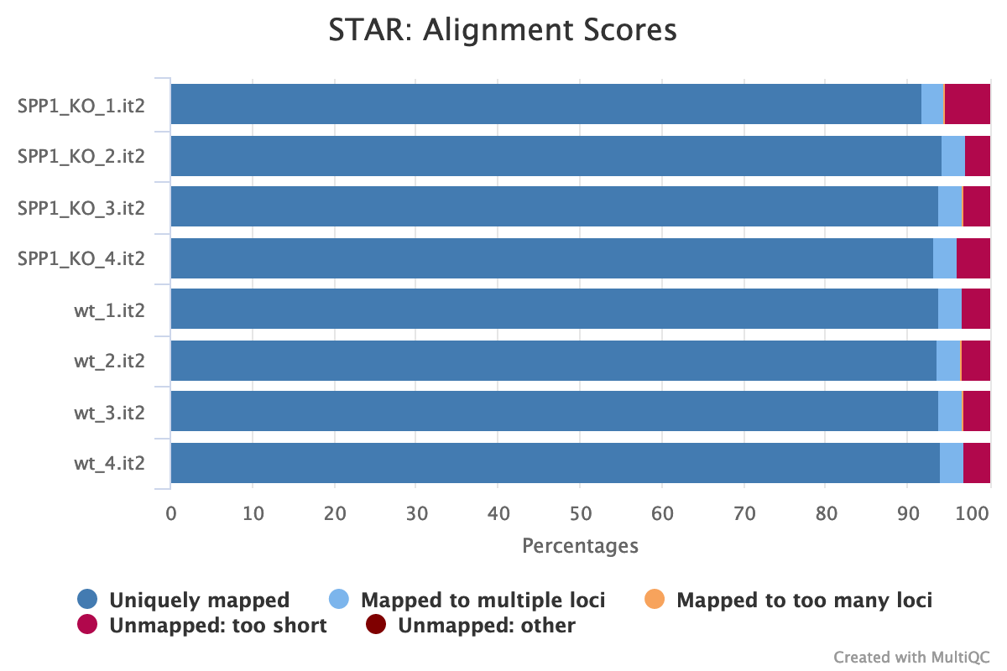
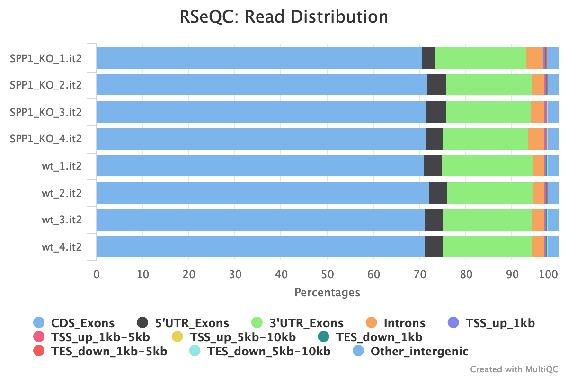
STAR Alignment QC

Slide 13
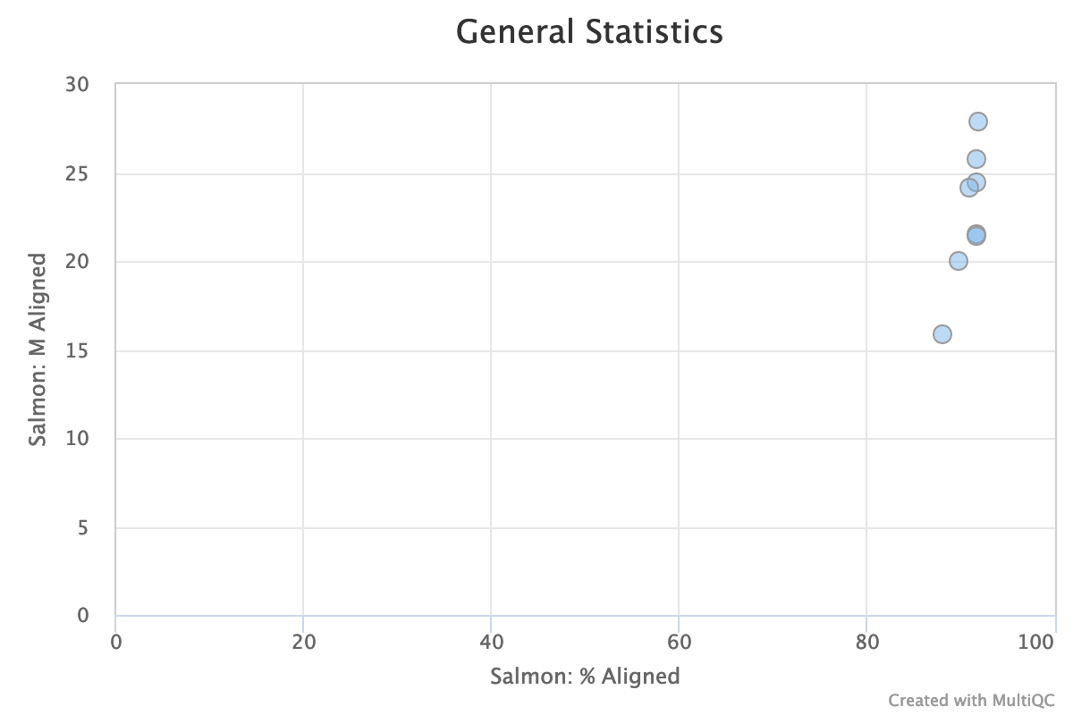
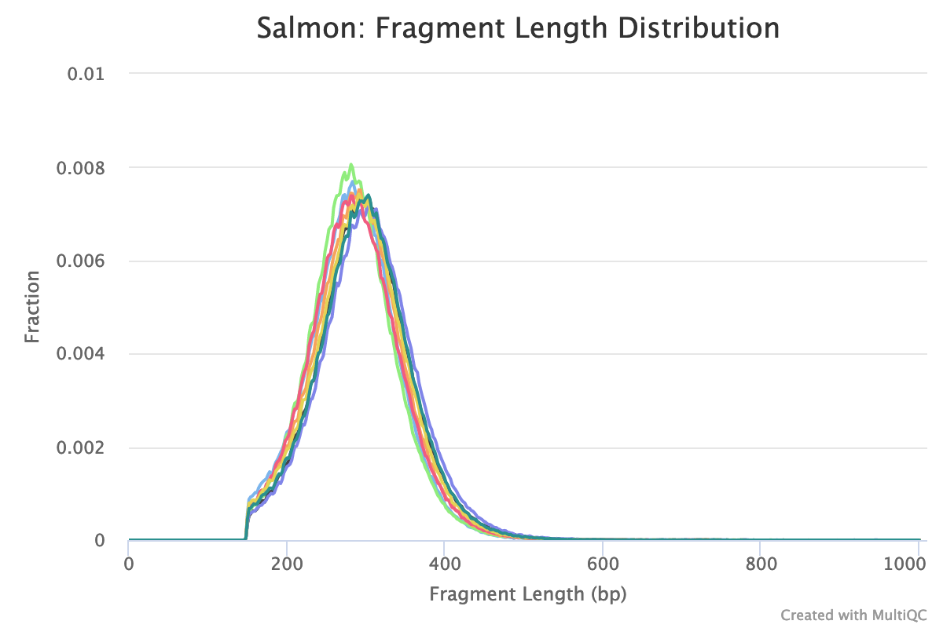
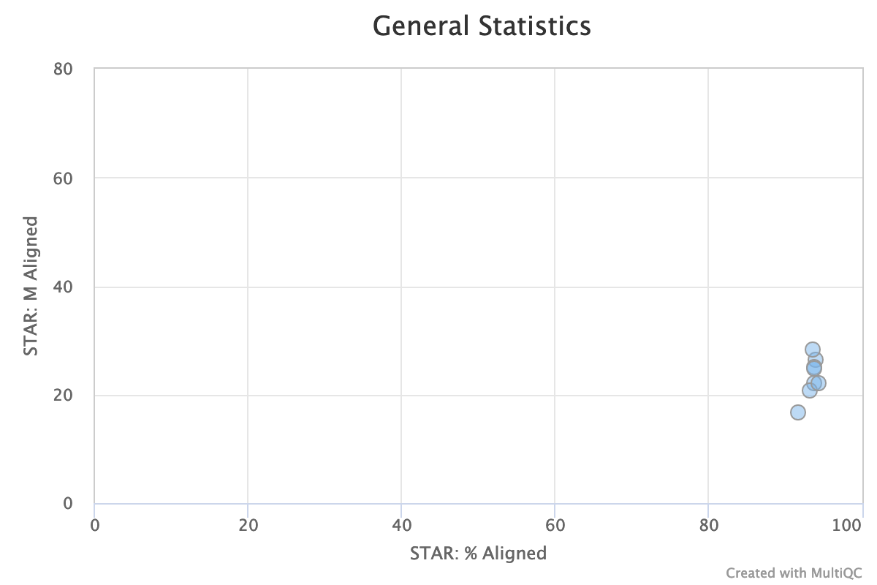
Salmon Quant QC

Slide 14
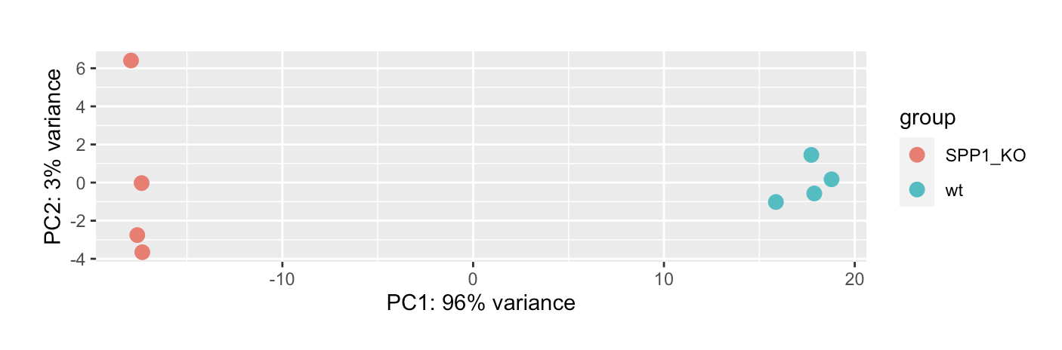
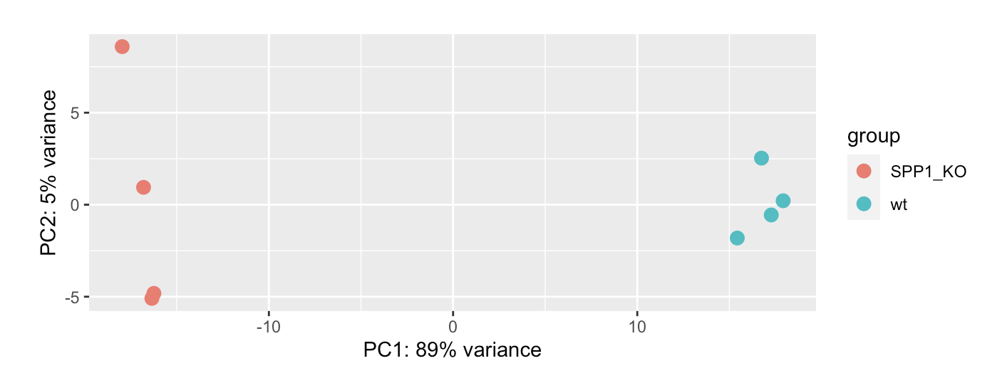
DESeq – Exploratory Data Analysis
STAR
Salmon

Slide 15
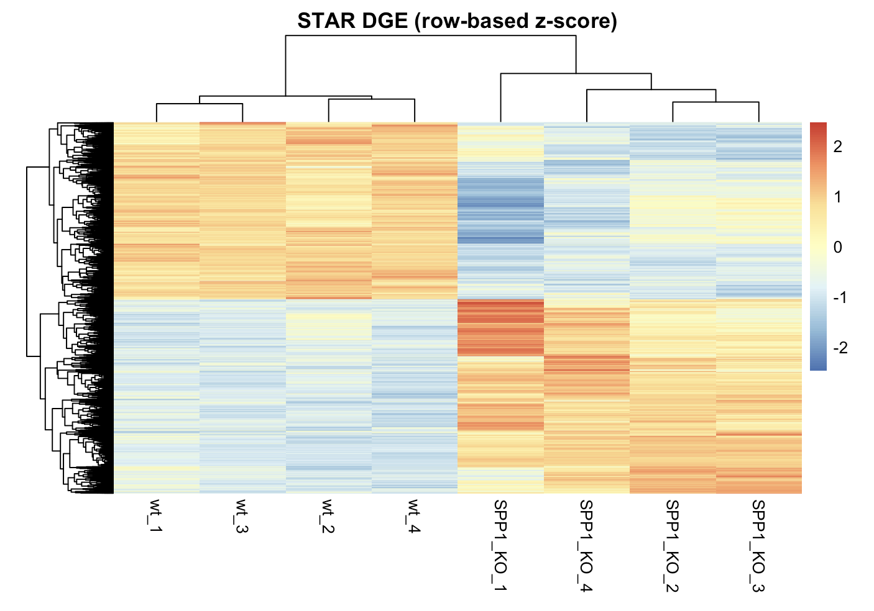
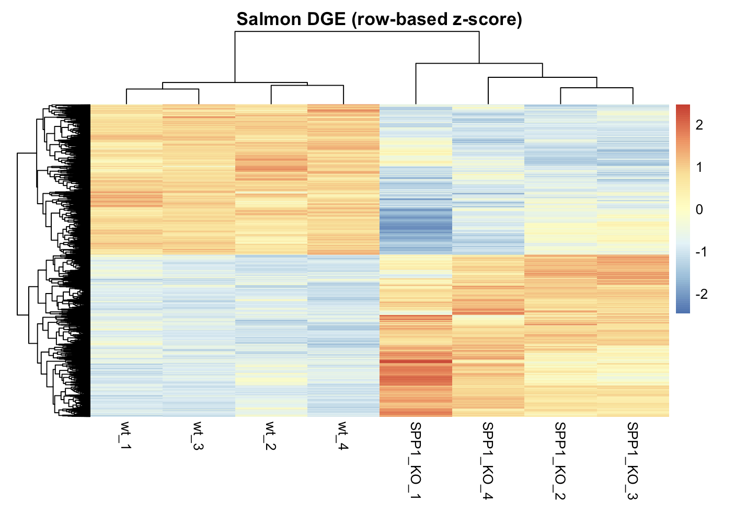
DESeq

Slide 16
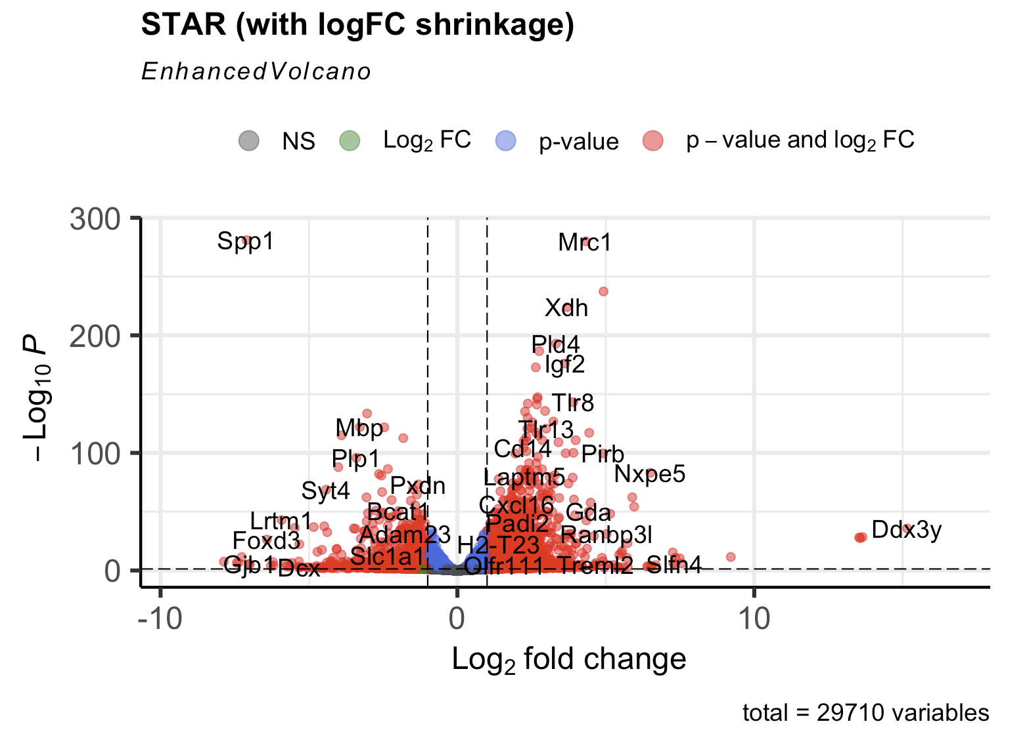
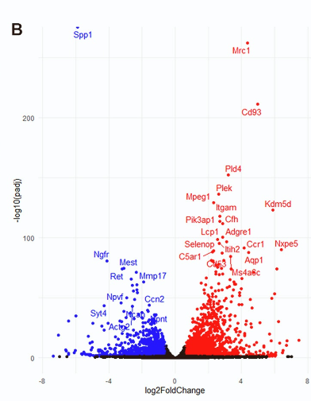
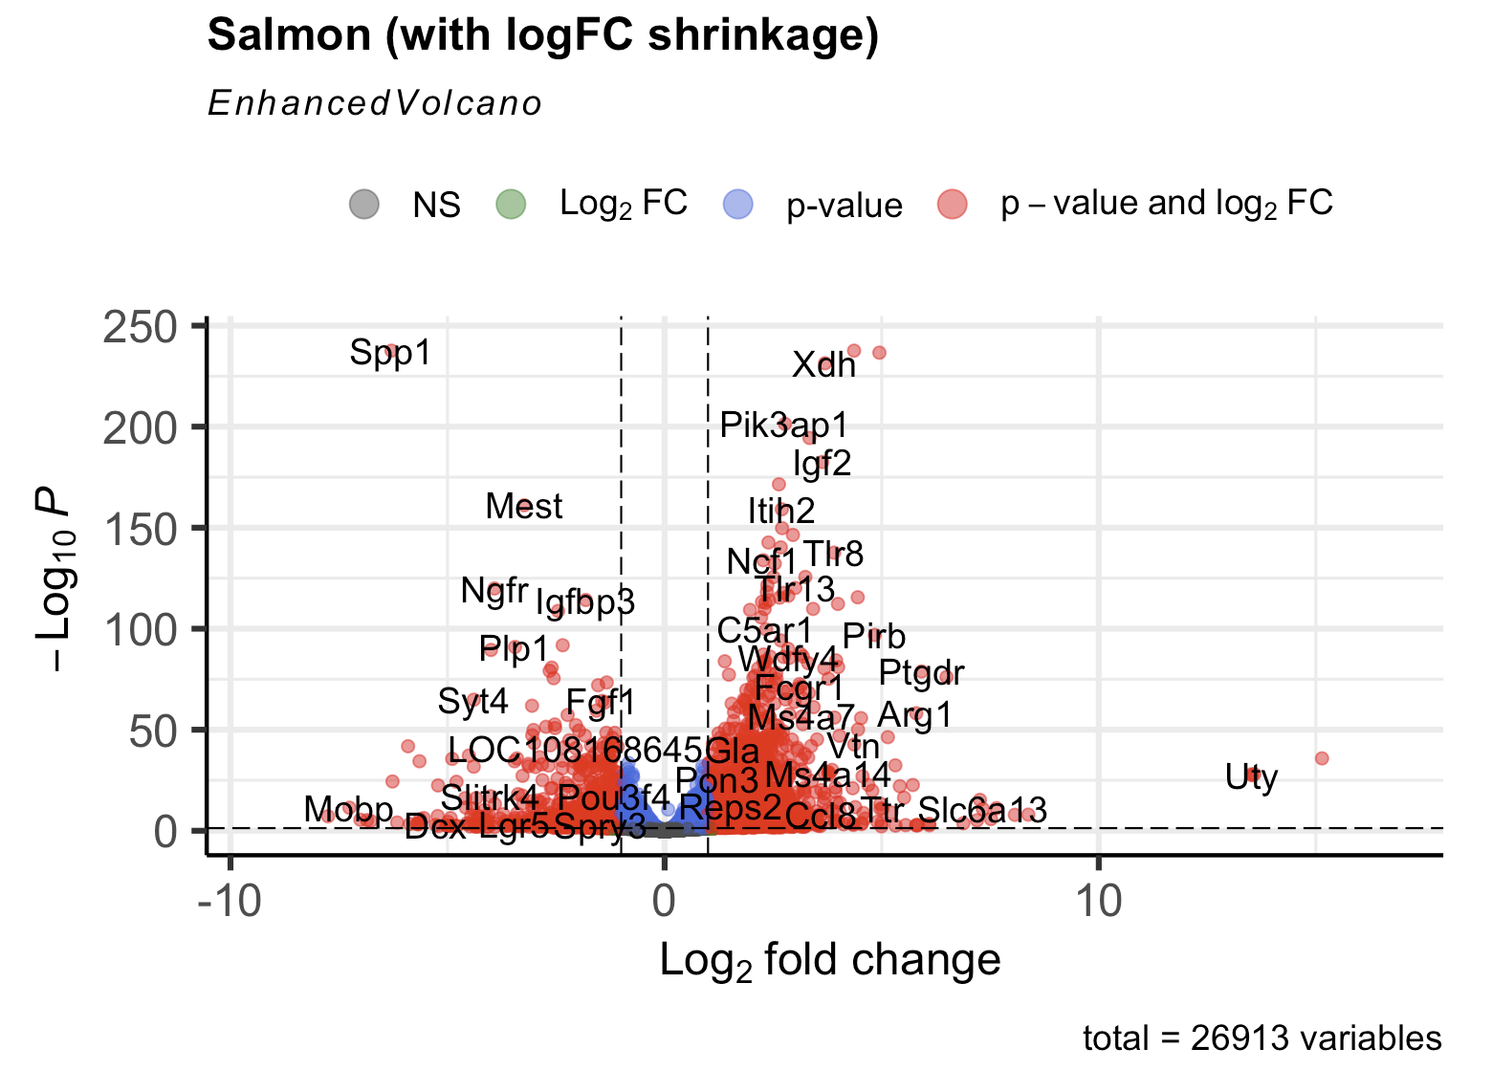
DESeq - DEGs

Slide 17
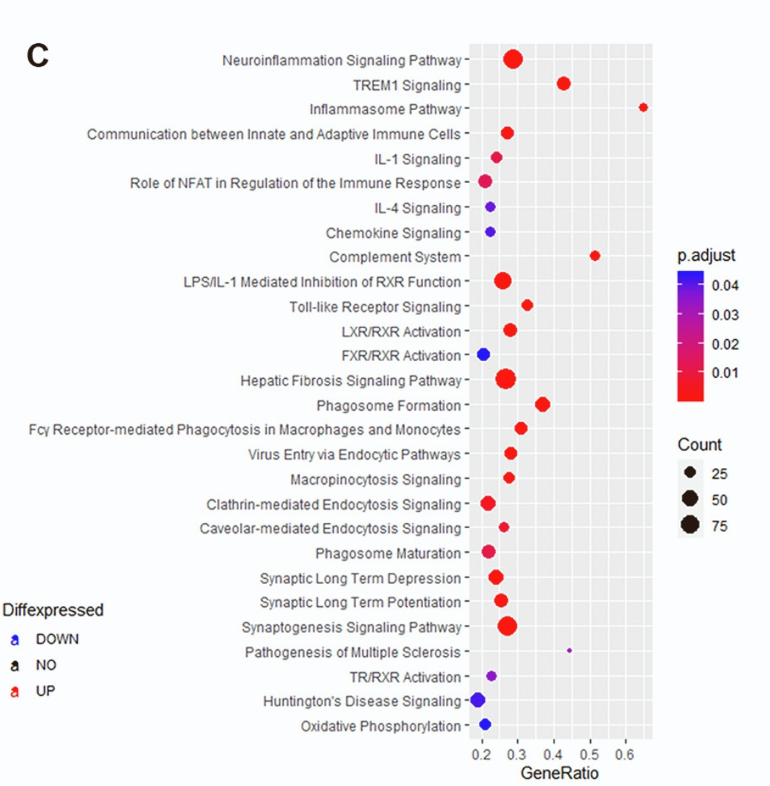
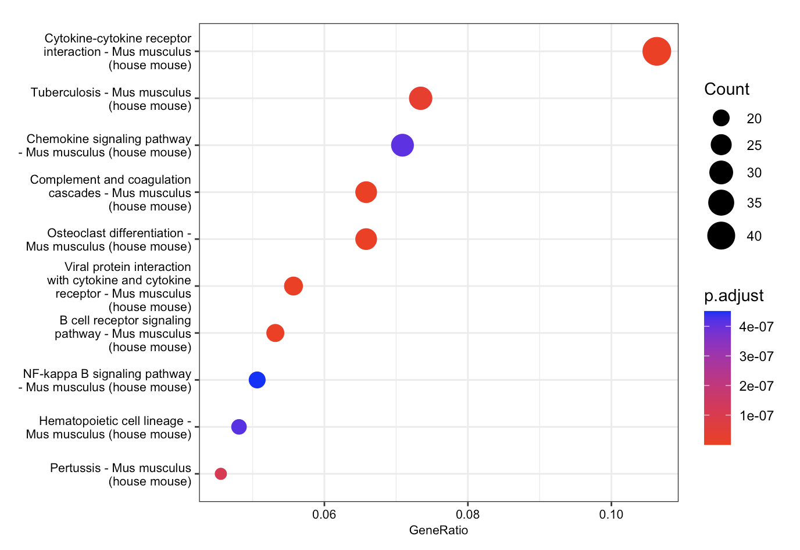
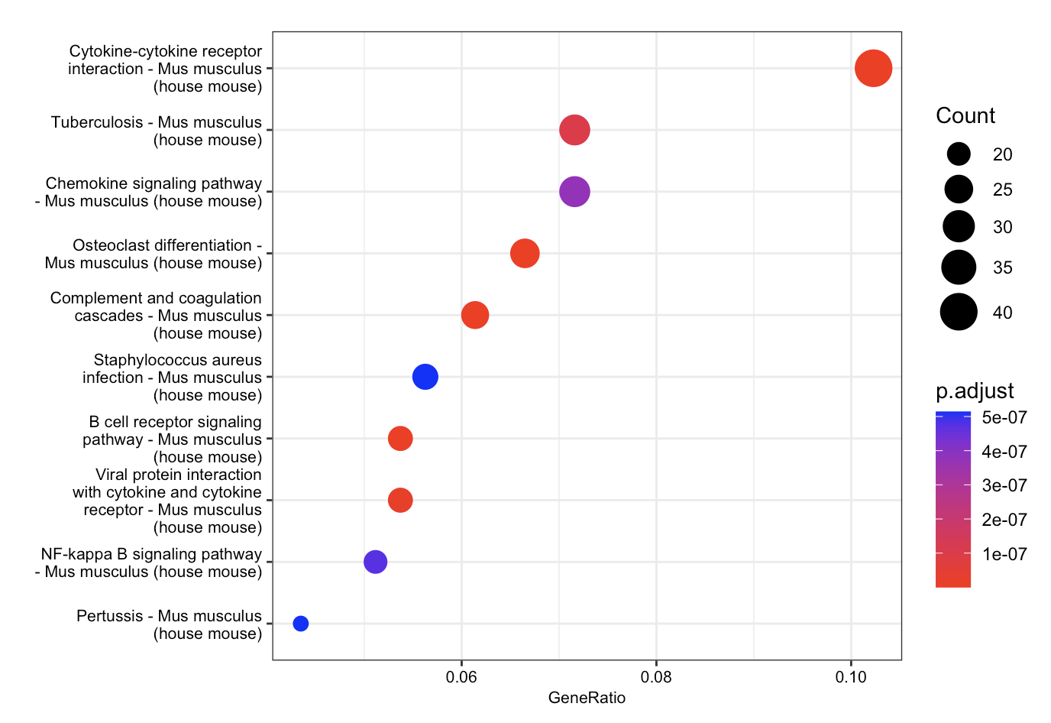
KEGG Enrichment
Li et al., 2022 Cell Reports
STAR
Salmon

Slide 18
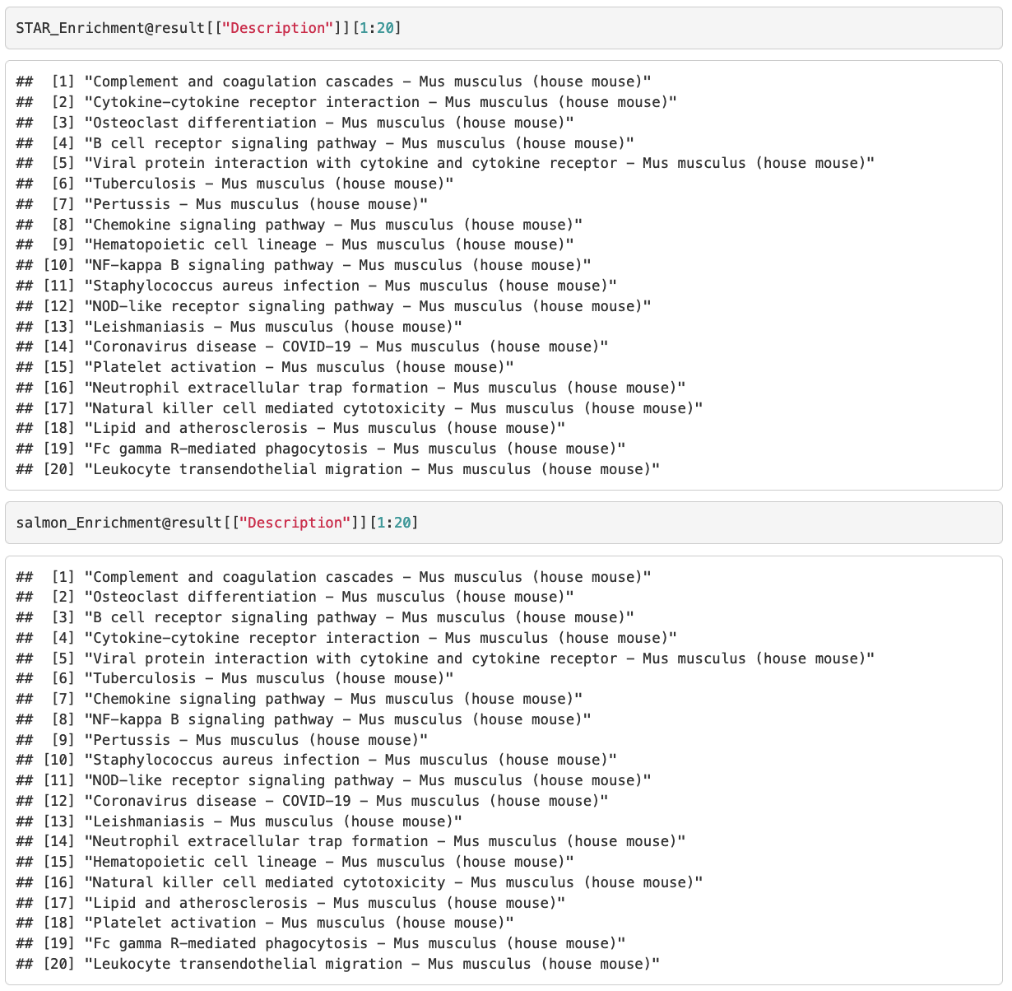
Results
At least 80% identity in the top 30 pathways

Slide 19
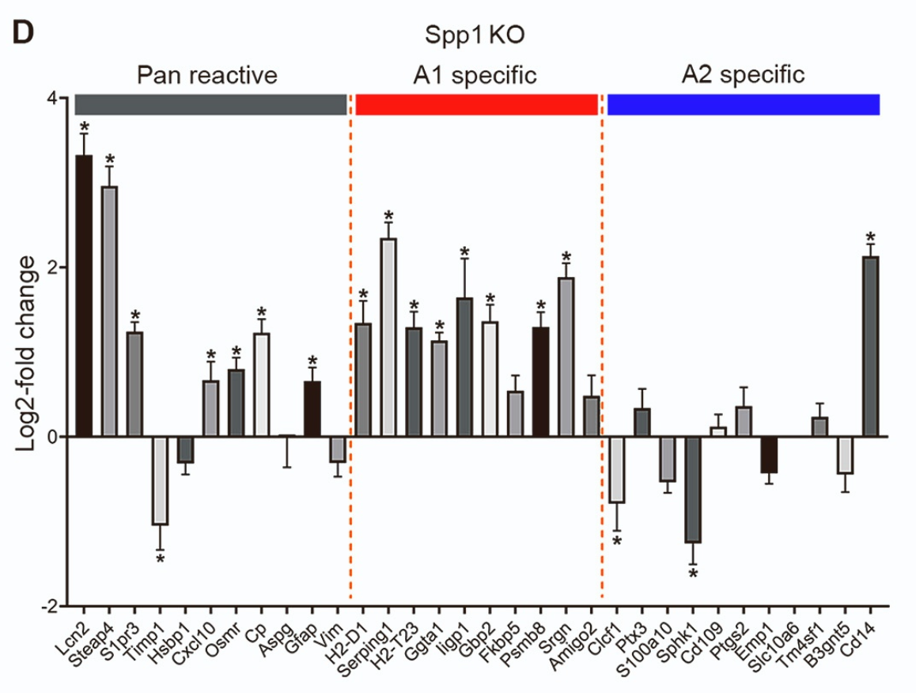
Background
‘‘pan-reactive’’ - set is commonly expressed in reactive astrocytes
‘‘A1’’ (or neuro- inflammatory) set associated with some pathological conditions (such as LPS injection)
‘‘A2’’ (or neuroprotective) set associated with other conditions, such as cerebral artery occlusion.40 In Spp1 KO astrocytes
Most pan-reactivity markers were up-regulated, as were most ‘‘A1’’ markers
Almost all markers specific for the ‘‘A2’’ neuroprotective type were down-regulated indicating that Spp1 deletion induced ‘‘A1’’ astrocytes.

Slide 20
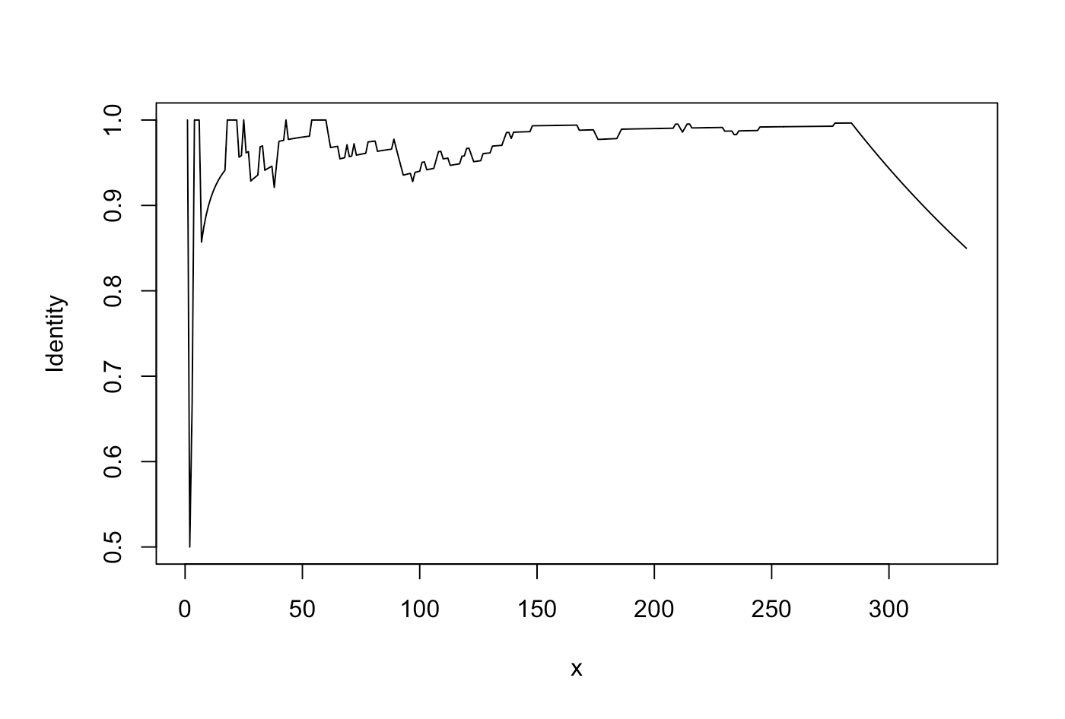
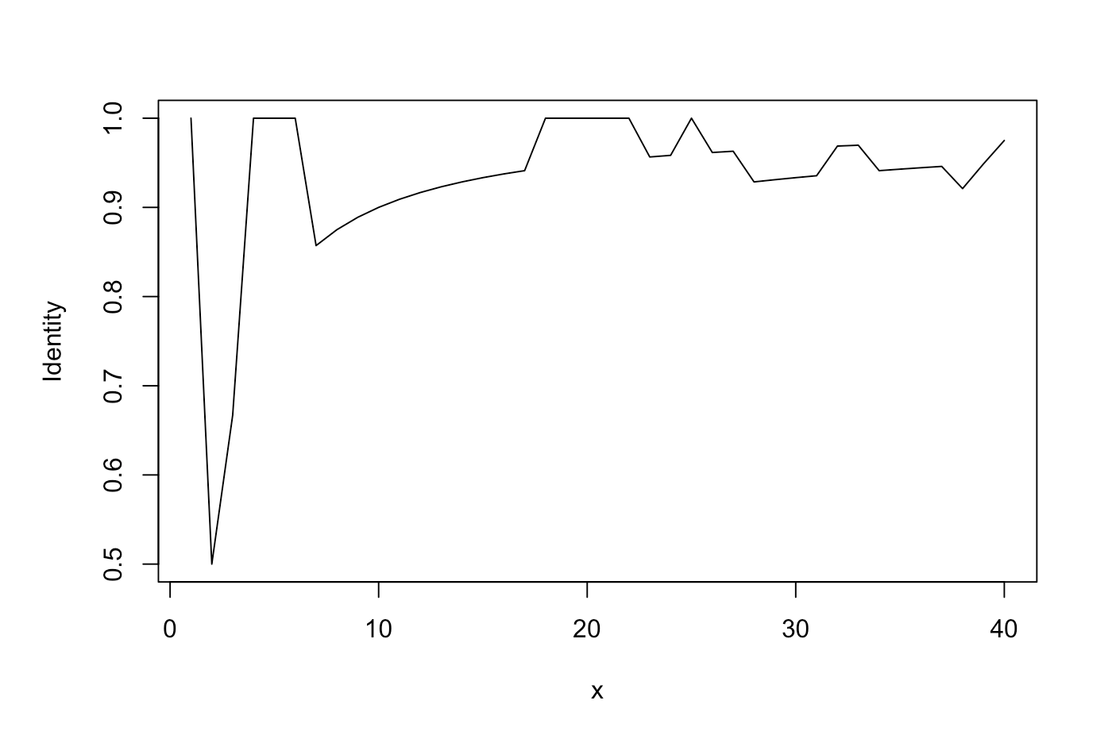
Results
Identity between STAR and Salmon Enriched pathways in the top x significant pathways

Slide 21
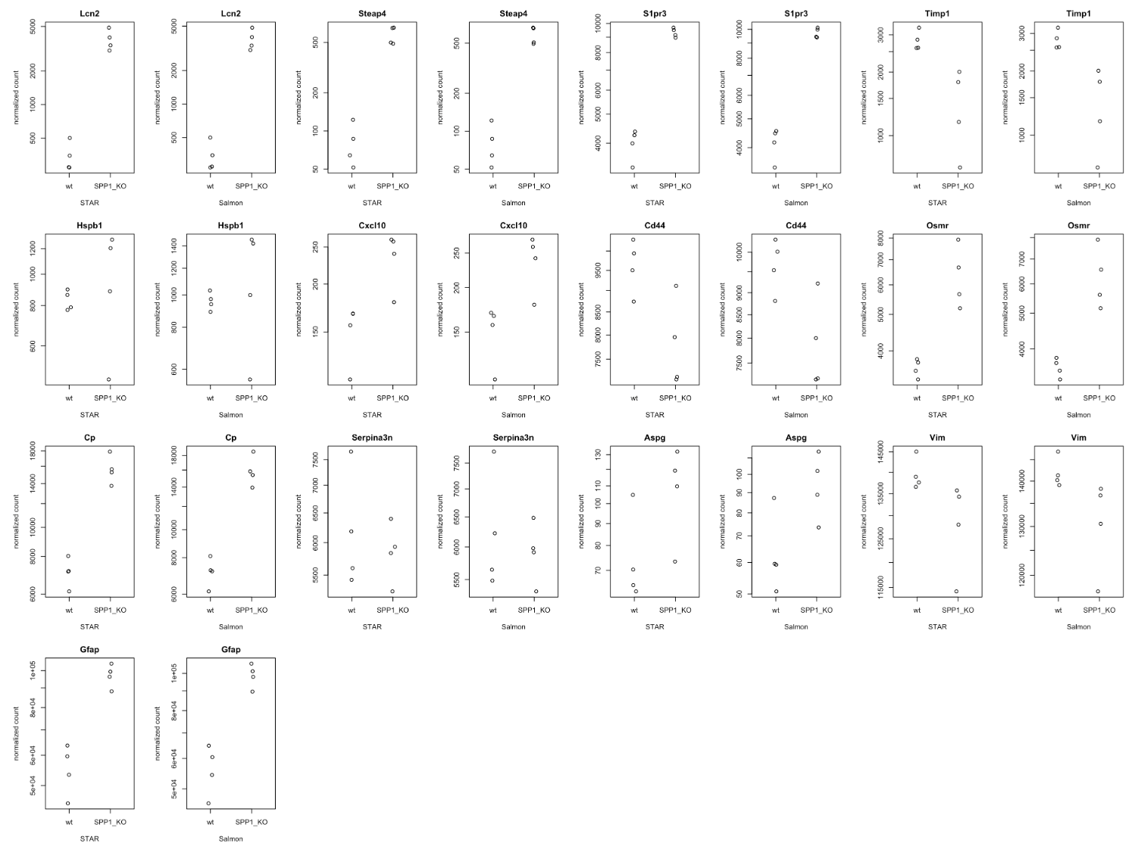
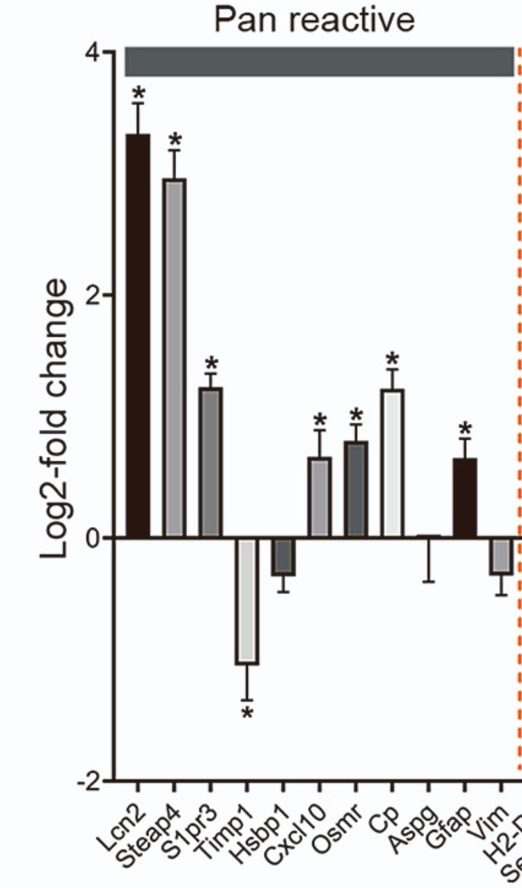
Naïve validation – Pan Reactive Genes up-regulated in SPP1_KO samples

Slide 22
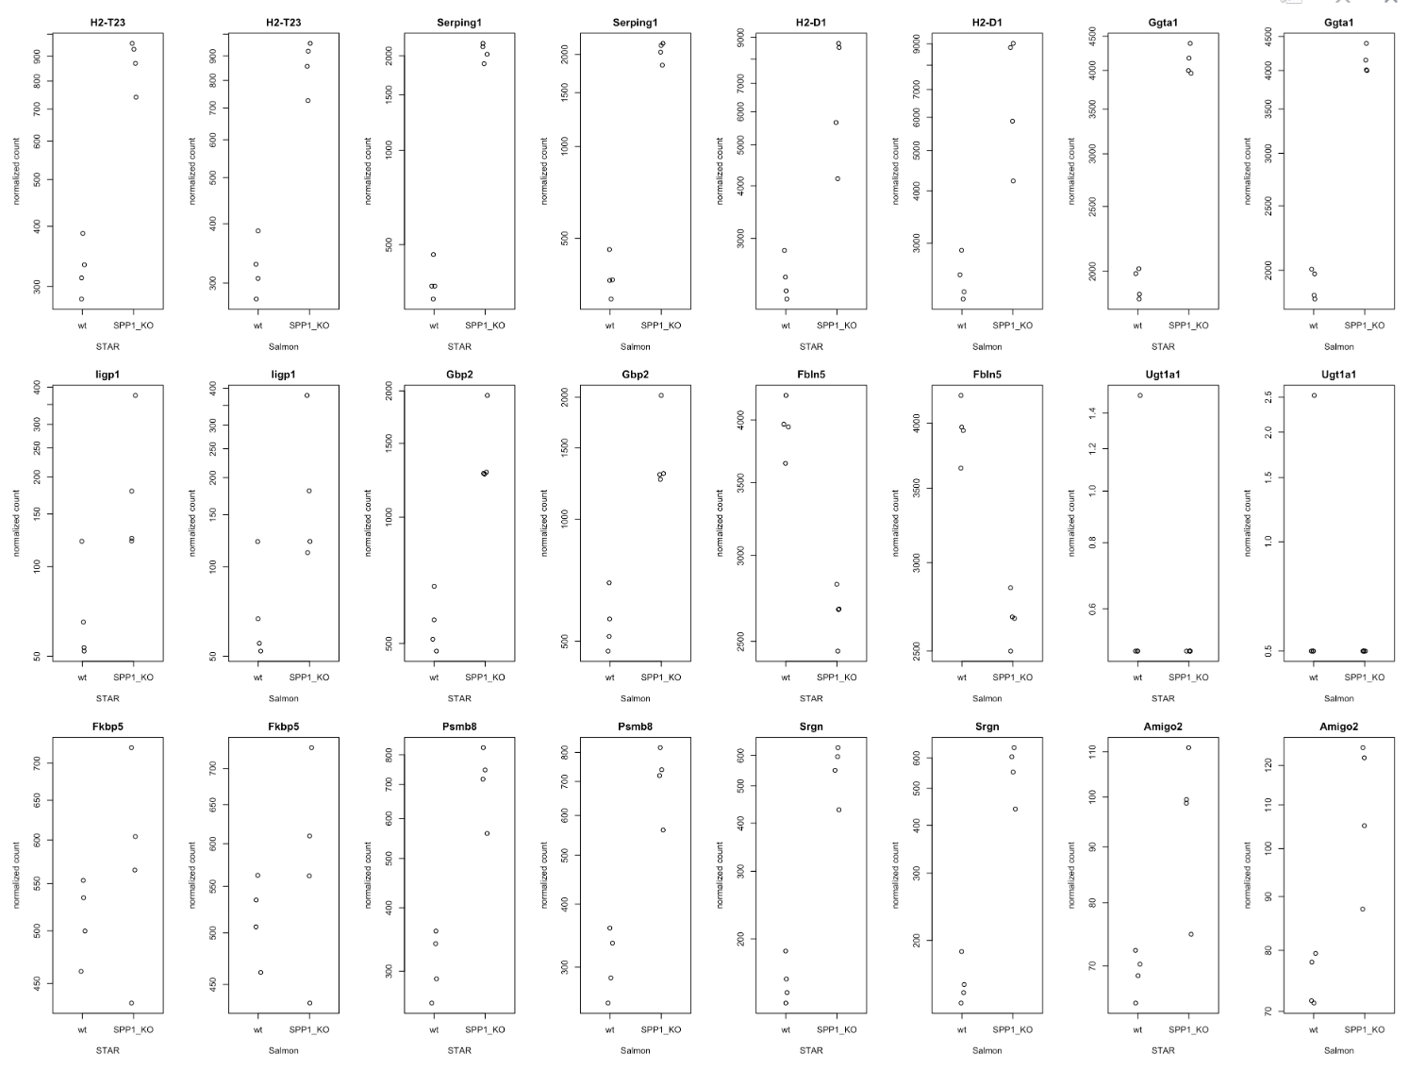
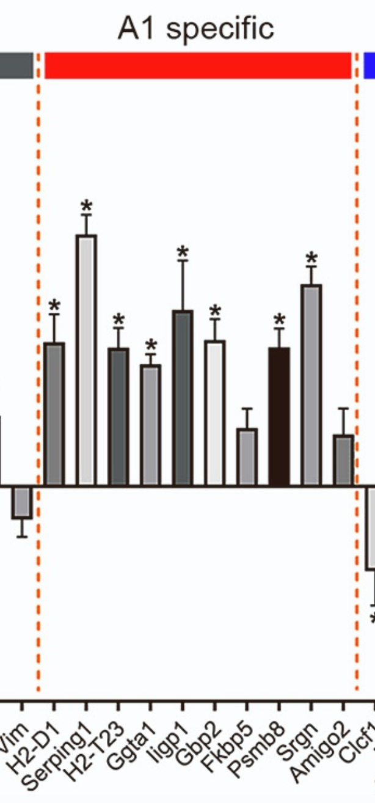
Naïve validation – A1-Specific Genes up-regulated in SPP1_KO samples

Slide 23
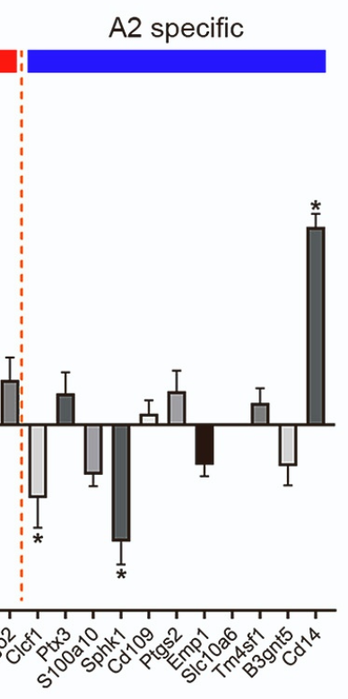
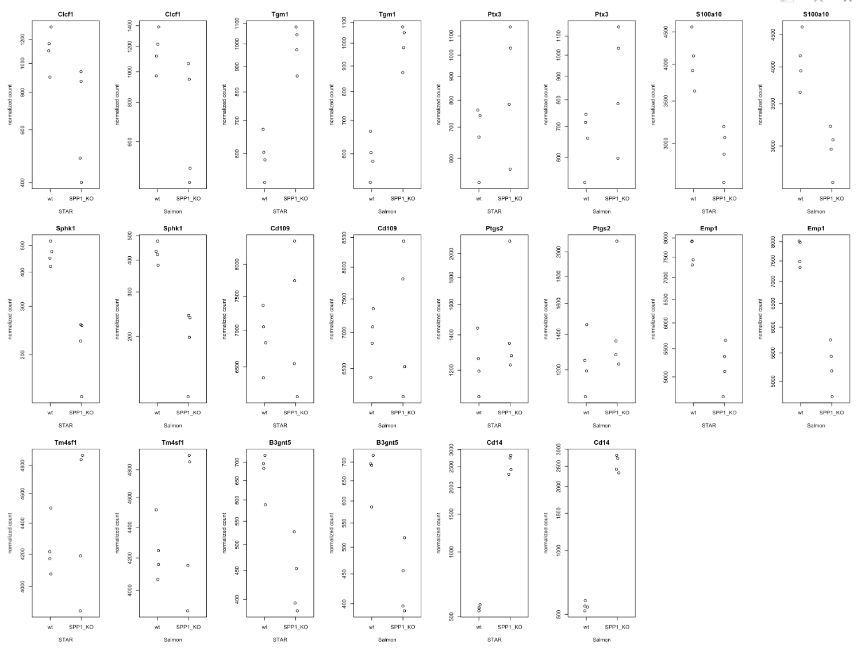
Naïve validation – A2-Specific Genes down-regulated in SPP1_KO samples

Slide 24
Conclusions
There appears to be no significant difference between the end results of both the algorithms when considering this functionality (Differential Gene Expression Analysis)
These results might be limited to well studied genomes. More research needs to be done on organisms that have not been indexed fully/do not have a fully sequenced genome
Conducting Gene Ontology assessment requires prior knowledge about the over-represented pathways that pop-up in certain genomes often, making a note of these GO terms while interpreting the results of GO enrichment will keep one from being misled due to these biases
Further well-thought-out GO analysis should be conducted on this dataset
Limitations of this dataset:
The authors did not disclose what kind of pathway analysis they’ve performed in the paper. This lead to a lot of confusion due to a mismatch between my results and the paper’s, post-EnrichKEGG using clusterProfiler
The authors also did not mention dealing with over-represented pathways based on the gene-ratio bias
The RNA-Seq analysis for this paper was delegated to the bioinformatics-core in Harvard explaining why the finer details for this analysis were not provided

Slide 25
Discussion/Problems Encountered
While creating an index using the “knowngene” version of the .gtf file lead to counting just the transcripts and not the genes since this file did not contain any gene_ids. I dealt with this problem by re-indexing the mm10 genome for both the algorithms using the ncbiRefSeq.gtf file from the UCSC table browser.
Performing the Gene Ontology analysis on the DESeq data turned out to be misleading since I did not apply the log2FC cutoff of 1.5. I corrected this by filtering out genes which have less than 1.5 log2FC
Adding the log2FC filter did not help produce identical pathway enrichment results displayed in the paper

Slide 26
Datasets
ncbiRefSeq GTF file: https://hgdownload.soe.ucsc.edu/goldenPath/mm10/bigZips/genes/mm10.ncbiRefSeq.gtf.gz
mm10 fasta file: http://ftp://hgdownload.soe.ucsc.edu/goldenPath/mm10/bigZips/mm10.fa.gz
GEO Dataset: https://www.ncbi.nlm.nih.gov/geo/query/acc.cgi?acc=GSE174522
Metadata TSV file: https://www.ebi.ac.uk/ena/browser/view/PRJNA730426
Research Article: https://doi.org/10.1016/j.celrep.2022.111880

Slide 27
GitHub
Link to GitHub repository - https://github.com/moa4020/STARvsSalmon.git

Slide 28
References
Srivastava A, Malik L, Sarkar H, et al. Alignment and mapping methodology influence transcript abundance estimation. Genome Biol. 2020;21(1):239. Published 2020 Sep 7. doi:10.1186/s13059-020-02151-8
Bray NL, Pimentel H, Melsted P, Pachter L. Erratum: Near-optimal probabilistic RNA-seq quantification. Nat Biotechnol. 2016;34(8):888. doi:10.1038/nbt0816-888d
Bray NL, Pimentel H, Melsted P, Pachter L. Near-optimal probabilistic RNA-seq quantification [published correction appears in Nat Biotechnol. 2016 Aug 9;34(8):888]. Nat Biotechnol. 2016;34(5):525-527. doi:10.1038/nbt.3519
Corchete LA, Rojas EA, Alonso-López D, De Las Rivas J, Gutiérrez NC, Burguillo FJ. Systematic comparison and assessment of RNA-seq procedures for gene expression quantitative analysis. Sci Rep. 2020;10(1):19737. Published 2020 Nov 12. doi:10.1038/s41598-020-76881-x
Li S, Jakobs TC. Secreted phosphoprotein 1 slows neurodegeneration and rescues visual function in mouse models of aging and glaucoma. Cell Rep. 2022;41(13):111880. doi:10.1016/j.celrep.2022.111880

